Slide 1
Migration & Eloquent ORM Session 7
Course : COMP6681 – Web Programming
Effective Period : September 2021

Slide 2
Learning Outcomes
LO3: Identify a proper web programming technic to build web based application

Slide 3
Outline
Laravel Database Settings
Definition of Migration
Rollback Migration
Creating a Migration
Alter Table Migration
Understanding Eloquent ORM
Model Creation & Access
Inputting, Updating & Deleting Data
Displaying Data
OneToOne relations
OneToMany relations
ManyToMany relations
Soft Delete

Slide 4
Laravel Database Settings
As we have seen, the database is a separate application from PHP.
There are many types of database applications. For PHP-based web applications, the most frequently used are MySQL/MariaDB, SQLite, PostgreSQL and SQL Server.
These four types of databases are supported by Laravel by default.In this material we will use the MySQL database (or MariaDB to be precise) built in by XAMPP.
In order to communicate with MySQL, it is necessary to set some Laravel configuration.

Slide 5
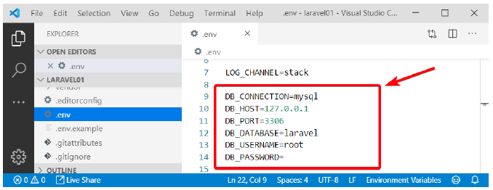
Laravel Database Settings
Configuration Files .env
Laravel's local configuration is in the .env file. Please open this file and look for the following line:
Fig 1. Database settings in .env file

Slide 6
Laravel Database Settings
There are 6 rows of database related settings:
DB_CONNECTION: Although it contains 'mysql' by default, this is not a setting about the database type, but rather a profile which contains the configuration set in the config/database.php file. But by default the 'mysql' profile contains the configuration to the MySQL database.
DB_HOST: Used to set the address of the database server. By default it already contains 127.0.0.1, which is the localhost address.
DB_PORT: Used to set the port of the database server application. By default it contains the number 3306, which is the default MySQL port.
DB_DATABASE: The name of the database to be used. By default it already contains 'laravel', which means Laravel will immediately search for a database named 'laravel'.
DB_USERNAME and DB_PASSWORD: Used to create a user name and password to login to the database server. By default the user name is root, and the password is not entered.

Slide 7
Definition of Migration
Migration is a Laravel feature to quickly generate tables. With just 1 php artisan command, one to tens of tables can be immediately available.
Migration is especially useful for projects created with teams. If a team member wants to try the app, there's no need to manually create a table from phpMyAdmin, but just run the migration file.
In more technical terms, migration is called version control for the database. Besides being used to create tables, we can also make step-by-step changes to the table structure.

Slide 8
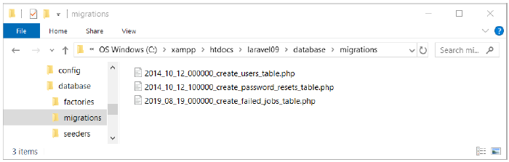
Definition of Migration
Laravel Default File Migration
Laravel already has some default migration files. This file is located in the database\migrations folder.
Fig 2. Database\migrations folder.

Slide 9
Definition of Migration
Laravel Default File Migration
In this folder there are 3 migration files, namely:
2014_10_12_000000_create_users_table.php
2014_10_12_100000_create_password_resets_table.php
2019_08_19_000000_create_failed_jobs_table.php
Each migration file is used to create 1 table. That is, these 3 migration files will create 3 tables into the database.
The migration file name begins with a timestamp, i.e. the time the file was created. In the example above, the migration file 2014_10_12_000000_create_users_table.php was created on October 12, 2014. After the timestamp, it is followed by the name of the migration.
However, the recommended writing format is as follows:
<timestamp>_<process>_<table_name(s)>_table.php

Slide 10
Definition of Migration
Laravel Default File Migration
Note that there is an additional 's' at the end. This is the plural or plural form of a word in English. In laravel, we suggest making the table name in plural form, how to add the letter s at the end of the word, such as students, lecturers, things, etc.

Slide 11
Running Migration
Next we will try to run the default Laravel migration file. These three migration files will create the users, password_resets and failed_jobs tables into the Laravel database that we have prepared.
To run the migration, please open cmd, go to the laravel folder and run the following command:
php artisan migrate

Slide 12
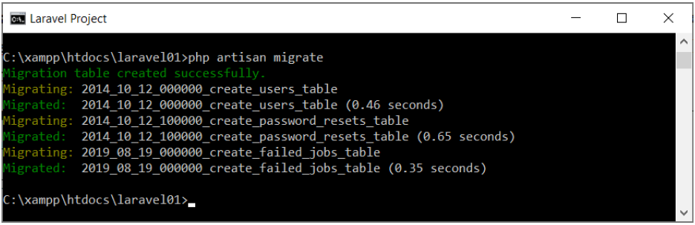
Running Migration
If the results appear as above, then the migration process has been running successfully. Please open phpMyAdmin and check the contents of the laravel database.:
Fig 3. Run the command php artisan migrate

Slide 13
Rollback Migration
When running the php artisan migrate command, the migration files will be executed sequentially according to the timestamp date. Files with the latest timestamp will run last.
If suddenly a problem occurs due to the addition of this table, we can do a partial rollback of the migration file. So it's as if returning to the database structure in the previous day
If we want to restore the position before the last migration file, we can use the following command:
In large projects, we can go back 6 or 10 steps if needed. The trick, simply set this value --step. For example, to go back 7 migration files, the command is php artisan migrate:rollback --step=7.
php artisan migrate:rollback --step=1.

Slide 14
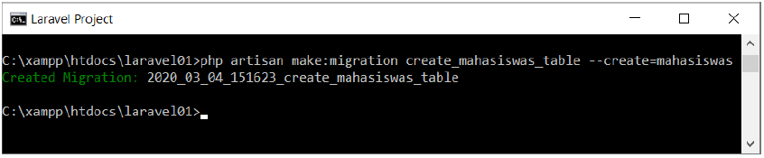
Creating Migration
A practical way to make a Migration is from the php artisan command with the following format:
For example, to create a Mahasiswas table migration file, you can run the following command:
As a result, in the database\migrations folder the file 2020_03_04_151623_create_mahasiswas_table.php will appear. The name of this file will be different because the timestamp date is generated automatically which is taken from the computer system.
php artisan make:migration <migration_name> --create=<table_name>
php artisan make:migration create_mahasiswas_table --create=mahasiswas
Fig 4. Creating migration files

Slide 15
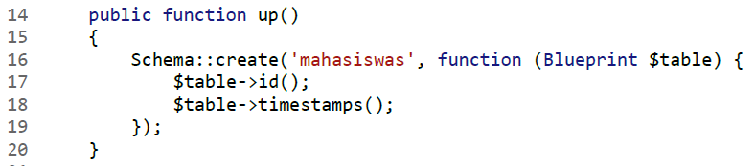
Creating Migration
Please open the migration file that has been created, you will find the file code as follows:
In the up() method only, because this is where to write the table structure.
Format penulisan nama kolom tabel adalah sebagai berikut:
Fig 5. Detail migration files for table structure
$table-><column_data_type>('<column_name>')

Slide 16
Creating Migration
For example, in line 17 there is a $table->id() method call, this is used to create a column of type big integer which is directly set with auto increment.
The complete table for the types of column data types that can be used, can be seen at the following link: https://laravel.com/docs/8.x/migrations#available-column-types
Immediately run the Migration file that was created with the command:
php artisan migrate

Slide 17
Alter Table Migration
Migration is not only used to create and delete tables, but also to modify the table structure (run an ALTER query). We do this quite often throughout the project creation.
In order to be able to modify tables into migrations, Laravel needs an additional library called Doctrine DBAL. The installation process of this library is very easy, just run the following command in the laravel folder:
Next, we want to modify the structure of the Mahasiswas table. Please create a new migration file with the name alter_mahasiswas_table:
composer require doctrine/dbal
php artisan make:migration alter_mahasiswas_table --table=mahasiswas

Slide 18
Understanding Eloquent ORM
Eloquent ORM is a database access method where each table row is considered as an object. The word ORM itself stands for Object-relational mapping, which is a programming technique to convert data into object form.
The way the ORM works is to convert table rows into an object. Writing techniques like this are very suitable for use in frameworks such as Laravel, all of which have implemented object-based programming concepts.

Slide 19
Creating Model
Eloquent ORM requires a Model for the process of converting table data into objects. This object is what we will access from inside the controller. Just like creating various files in Laravel, there is a php artisan command for creating Models.
The following is the basic format of the command used:
The model name must be paired with the table name but in singular form. If we create a mahasiswas table, then the model name is Mahasiswa, or if we have a matakuliahs table, the model name is Matakuliah.
php artisan make:model <Modelname>

Slide 20
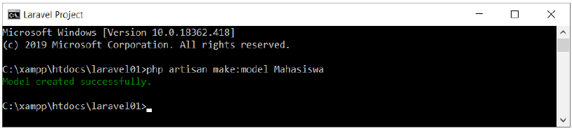
Creating Model
Since we already have a mahasiswas table, the commands we need are:
After this command is executed, a new file named Mahasiswa.php will appear in the app\Models folder.
php artisan make:model Mahasiswa
Fig 6. Creating model Mahasiswa

Slide 21
Model Access
Program code generation with Eloquent ORM is still done from the controller. It's just that now we need to access the Model, namely the Mahasiswa class in the Mahasiswa.php file.
This Mahasiswa class must first be imported into the controller. To do this, write the following code at the top of the MahasiswaController file:
Thus, we can already access the Mahasiswa model throughout the controller. Here's the code display from MahasiswaController.php.
use App\Models\Mahasiswa;

Slide 22
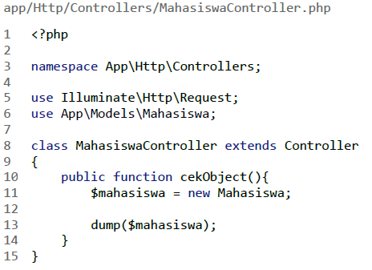
Model Access
In line 6 there is an additional command use App\Models\Student which is used to import the Mahasiswa model file.
Fig 7. Display MahasiswaController

Slide 23
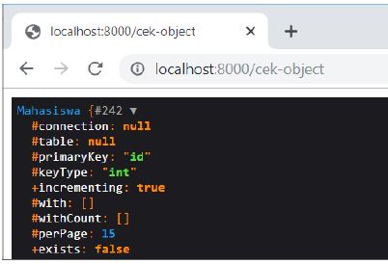
Model Access
Then in the checkObject() method, we instantiate the Mahasiswa class which is stored in the $student variable. The $student variable is then dump() with the following result:
Fig 8. Result dump($mahasiswa)

Slide 24
Inputting Data
The process of inputting data using Eloquent ORM is quite simple. The trick is to create an object from the Mahasiswa model, input data into the attributes that correspond to the table column names,and finally run the save() method. The following is the program code in question:
app/Http/Controllers/MahasiswaController.php
1 <?php
2
3 class MahasiswaController extends Controller
{
public function insert(){
$mahasiswa = new Mahasiswa;
$mahasiswa->nim = '19003036';
$mahasiswa->nama = 'Sari Citra Lestari';
$mahasiswa->tanggal_lahir = '2001-12-31';
$mahasiswa->ipk = 3.5;
$mahasiswa->save();
dump($mahasiswa);
}
}

Slide 25
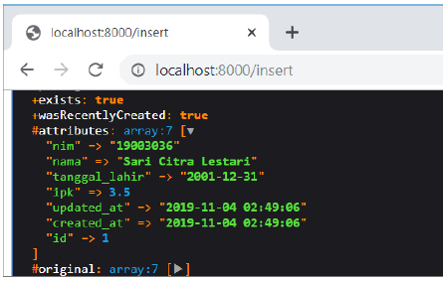
Inputting Data
In line 6 there is the process of instantiating the Mahasiswa class into the $Mahasiswa object. Then in rows 7-10 we can fill in some properties that are the same as the table column names. Not all fields must be filled in, depending on needs and as long as they are in accordance with the conditions in the table.
In line 11, the $student->save() method is used to save these data into the database. And finally our $student object dump() to see its contents.
Execute the above method by opening the address localhost:8000/insert. From the dump() output, please open #attributes:
Fig 9. Result localhost:8000/insert

Slide 26
Updating Data
Eloquent ORM processes table data using objects. For the update process, the trick is that we have to find the Model object from the table, then change some properties and save it again. Here's a practical example:
app/Http/Controllers/MahasiswaController.php
1 <?php
2
3 class MahasiswaController extends Controller
{
public function update(){
$mahasiswa = Mahasiswa::find(1);
$mahasiswa->tanggal_lahir = '2001-12-31';
$mahasiswa->ipk = 2.9;
$mahasiswa->save();
dump($mahasiswa);
}
}

Slide 27
Updating Data
In line 6 there is the Mahasiswa::find(1) command. The find() method is used to find table data based on the id column. This means that the Mahasiswa::find(1) command will retrieve data in the Mahasiswa table that has id = 1, then create an object from that data. This object is then stored in the $mahasiswa variable.
Then in rows 7 and 8, we enter data '2001-01-01' into $mahasiswa>tanggal_lahir, and data 2.9 into $mahasiswa->ipk. These two values will overwrite the existing data, namely data from students with id = 1.
To save changes to the database, end with the $student->save() command as in line 9. Run this code by accessing the localhost:8000/update page:

Slide 28
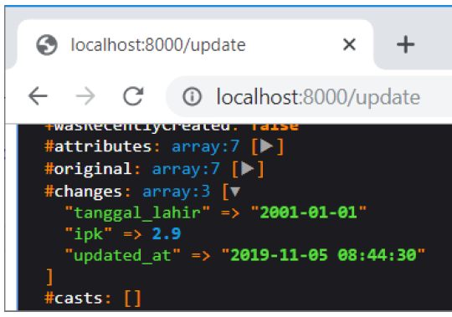
Updating Data
From the results of the dump($mahasiswa), please open the #changes tab, it contains 3 changed data, namely tanggal_lahir, ipk, and update_at. Note that Eloquent immediately updates the update_at column when the update occurs, we don't need to do this manually.
Fig 10. Result localhost:8000/update

Slide 29
Deleting Data
The process of deleting data with Eloquent is very simple, simply by accessing the delete() method of the Model object. But before that we must first find the Model object that we want to delete. Here's an example of deleting data using Eloquent ORM:
In line 5 we use the find(1) method to find student data that has id = 1. After the object is obtained, just run the delete() method as in line 7. Run the above code by going to the localhost:8000/delete page.
As a result, the student data for 'Sari Citra Lestari' no longer exists.
app/Http/Controllers/MahasiswaController.php
1 <?php
2
3 class MahasiswaController extends Controller
{
public function delete(){
$mahasiswa = Mahasiswa::find(1);
$mahasiswa->delete();
dump($mahasiswa);
}
}

Slide 30
Displaying Data
Displaying data with Eloquent ORM means that we will be dealing a lot with objects and collections. Some methods return only one Model object, but some methods return a collection consisting of many Model objects.
Method All(), This method serves to retrieve all data from the table.
Displaying data directly in the controller doesn't feel right, because this data should be sent to the view first.
In MahasiswaController.php, we create the method All() to display data from Eloquent so that it can appear in the View.
The following is a sample program code to send Eloquent data into the View :

Slide 31
Displaying Data
The result of Mahasiswa::all() is already in the form of a collection, so it can be directly forwarded to the View tampil-mahasiswa by writing ['mahasiswas' => $mahasiswas].
Please create a view tampil-mahasiswa.blade.php with the following code:
app/Http/Controllers/MahasiswaController.php
<?php
class MahasiswaController extends Controller
{
public function allView(){
$mahasiswas = Mahasiswa::all();
return view('tampil-mahasiswa',['mahasiswas' => $mahasiswas]);
}
}

Slide 32
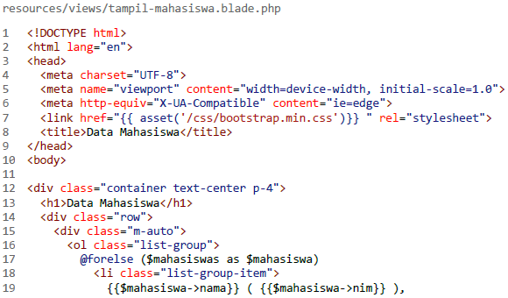
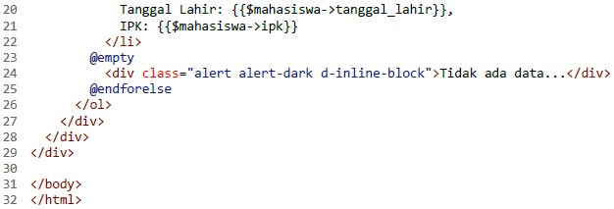
Displaying Data
Fig 11. Result view tampil-mahasiswa.blade.php

Slide 33
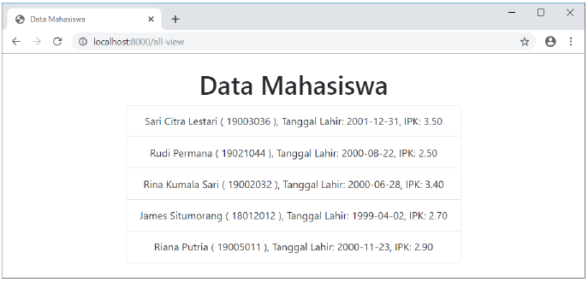
Displaying Data
The essence of this view in fig 11 is in lines 17 – 22, namely the @forelse loop to display the contents of the $mahasiswas variable. Note that the contents of the $student variable must be in the form of an array or collection, if it is in the form of another data type, the @forelse loop will result in an error.
Fig 12. Data from Eloquent is displayed in view

Slide 34
Displaying Data
Method where(), To retrieve some data from the table, we can use the where() method. It's used the same way as the where() method in the Collection and Query Builder content.
For example, we want to display all students with GPA < 3, and sorted by name in descending order. Here's the program code:
app/Http/Controllers/MahasiswaController.php
<?php
class MahasiswaController extends Controller
{
public function getWhere(){
$mahasiswas = Mahasiswa::where('ipk','<','3')
->orderBy('nama', 'desc')
->get();
return view('tampil-mahasiswa',['mahasiswas' => $mahasiswas]);
}
}

Slide 35
One To One Relations
A one-to-one relationship is a very basic relation. For example, a User model might be associated with one Phone. To define this relationship, we place a phone method on the User model. The phone method should call the hasOne method and return its result:
<?php
namespace App\Models;
use Illuminate\Database\Eloquent\Model;
class User extends Model
{
/**
* Get the phone associated with the user.
*/
public function phone()
{
return $this->hasOne(Phone::class);
}
}

Slide 36
One To One Relations
Defining The Inverse Of The Relationship. So, we can access the Phone model from our User. Now, let's define a relationship on the Phone model that will let us access the User that owns the phone. We can define the inverse of a hasOne relationship using the belongsTo method:
<?php
namespace App\Models;
use Illuminate\Database\Eloquent\Model;
class Phone extends Model
{
/**
* Get the user that owns the phone.
*/
public function user()
{
return $this->belongsTo(User::class);
}
}

Slide 37
One To Many Relations
A one-to-many relationship is used to define relationships where a single model owns any amount of other models. For example, a blog post may have an infinite number of comments. Like all other Eloquent relationships, one-to-many relationships are defined by placing a function on your Eloquent model:
<?php
namespace App\Models;
use Illuminate\Database\Eloquent\Model;
class Post extends Model
{
/**
* Get the comments for the blog post.
*/
public function comments()
{
return $this->hasMany(Comment::class);
}
}

Slide 38
One To Many Relations
One To Many (Inverse). Now that we can access all of a post's comments, let's define a relationship to allow a comment to access its parent post. To define the inverse of a hasMany relationship, define a relationship function on the child model which calls the belongsTo method:
<?php
namespace App\Models;
use Illuminate\Database\Eloquent\Model;
class Comment extends Model
{
/**
* Get the post that owns the comment.
*/
public function post()
{
return $this->belongsTo(Post::class);
}
}

Slide 39
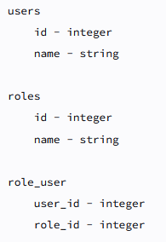
Many To Many Relations
Many-to-many relations are slightly more complicated than hasOne and hasMany relationships. An example of a many-to-many relationship is a user that has many roles and those roles are also shared by other users in the application. For example, a user may be assigned the role of "Author" and "Editor"; however, those roles may also be assigned to other users as well. So, a user has many roles and a role has many users.
Fig 13. relationship's table structure

Slide 40
Many To Many Relations
Many-to-many relationships are defined by writing a method that returns the result of the belongsToMany method. The belongsToMany method is provided by the Illuminate\Database\Eloquent\Model base class that is used by all of your application's Eloquent models
<?php
namespace App\Models;
use Illuminate\Database\Eloquent\Model;
class User extends Model
{
/**
* The roles that belong to the user.
*/
public function roles()
{
return $this->belongsToMany(Role::class);
}
}

Slide 41
Many To Many Relations
To define the "inverse" of a many-to-many relationship, you should define a method on the related model which also returns the result of the belongsToMany method. To complete our user / role example, let's define the users method on the Role model:
<?php
namespace App\Models;
use Illuminate\Database\Eloquent\Model;
class Role extends Model
{
/**
* The users that belong to the role.
*/
public function users()
{
return $this->belongsToMany(User::class);
}
}

Slide 42
Soft Deletes
In addition to actually removing records from your database, Eloquent can also "soft delete" models. When models are soft deleted, they are not actually removed from your database. Instead, a deleted_at attribute is set on the model indicating the date and time at which the model was "deleted". To enable soft deletes for a model, add the Illuminate\Database\Eloquent\SoftDeletes trait to the model:
<?php
namespace App\Models;
use Illuminate\Database\Eloquent\Model;
use Illuminate\Database\Eloquent\SoftDeletes;
class Flight extends Model
{
use SoftDeletes;
}

Slide 43
Soft Deletes
You should also add the deleted_at column to your database table. The Laravel schema builder contains a helper method to create this column:
use Illuminate\Database\Schema\Blueprint;
use Illuminate\Support\Facades\Schema;
Schema::table('flights', function (Blueprint $table) {
$table->softDeletes();
});
Schema::table('flights', function (Blueprint $table) {
$table->dropSoftDeletes();
});

Slide 44
References
Lukmanul Hakim. (2020). Konsep & implementasi Pemrograman LARAVEL 7 Edisi BEST PRACTICE. CV. LOKOMEDIA. Yogyakarta. ISBN: 978-602-6231-25. Chapter 7-8
Andre Pratama. (2019). Laravel Uncover. DuniaIlkom.
https://laravel.com/docs/8.x/eloquent-relationships#one-to-one
https://laravel.com/docs/8.x/eloquent-relationships#one-to-many
https://laravel.com/docs/8.x/eloquent-relationships#many-to-many
https://laravel.com/docs/8.x/eloquent#soft-deleting
https://www.youtube.com/watch?v=g-63ClKANsM

Slide 45
Thank You

